Slide 1
Basic GIT
Nook

Slide 2
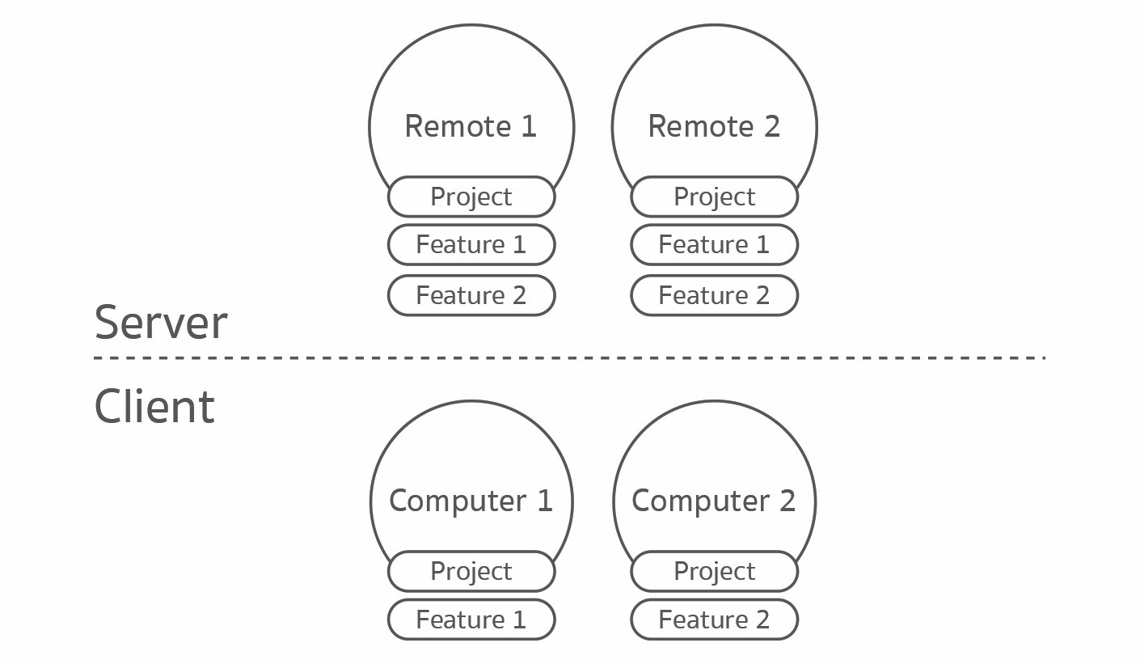
Introduction
Remote
Local

Slide 3
Start using GIT
Using Command Line
Local
Remote
git init
On first time only
git push
git commit –m”message”
git fetch
git pull
git add .
git commit –m”message”

Slide 4
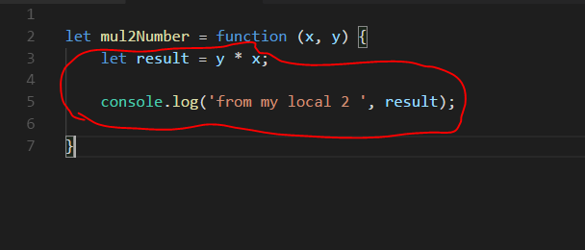
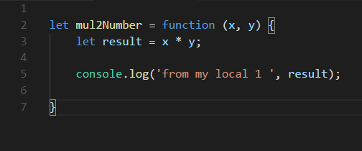
Git Conflict
Remote
simple.js
simple.js
Local A
Local B

Slide 5
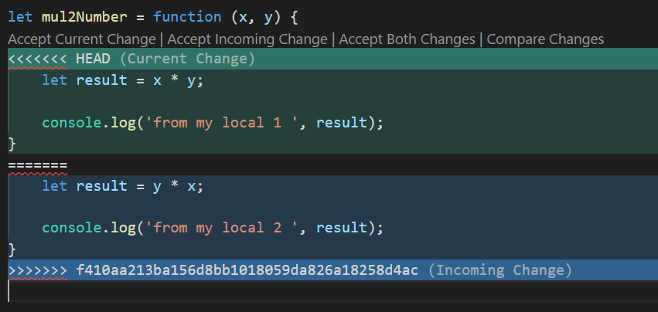
Git Conflict (cont.)
Local
Step:
Pull code from remote
fix conflict
Merge Commit
Push to remote

Slide 6
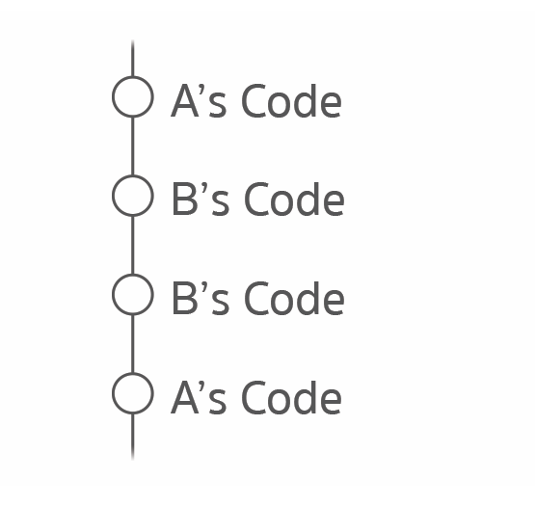
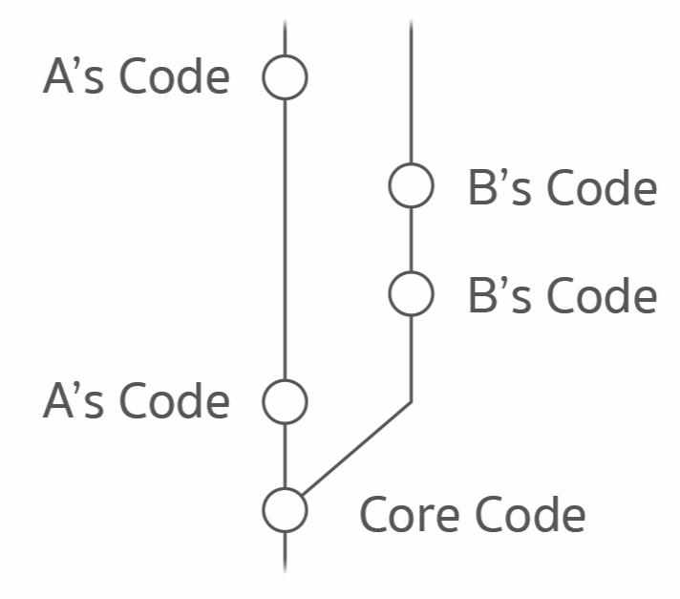
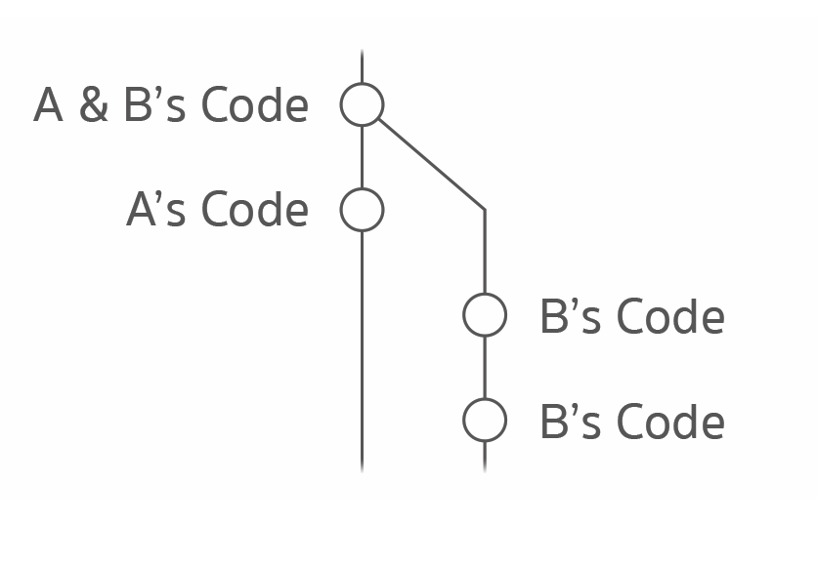
Git Branch
git branch b-name
git checkout b-name
git merge b-name

Slide 7
summary
git init : initial new git
git clone : get repository from remote
git add . || <file_name> : tage file
git commit –m”message” : save point
git branch : get all branch name
git branch <new_name> : create new branch
git checkout <branch_name> : switch to branch
git pull : get code from remote to local
git push : push code from local to remote
git status : check current status
git merge <branch_name> : merge current branch with <branch_name>

Slide 8
Homework 1
1: clone project from https://github.com/nuenook/basicGit.git
2: create branch with your name
3: write answers in question.md
4: save and push code to your branch on remote.
https://github.com/nuenook/basicGit.git

Slide 9
Homework 2
1: create new project then initial git command
2: save change code
3: push to public Github by your-account
4: can share this Github project link to everyone

Slide 10
Homework 3
1: clone project from https://github.com/nuenook/basicGit.git
2: switch to nook branch
4: create new branch name: nook-edit
5: look at refect.js and then change declare variable from var to let
6: merge nook branch with nook-edit branch
7: save and push code to nook branch on remote
8: delete nook-edit branch on remote
https://github.com/nuenook/basicGit.git

Slide 11
END
https://blog.nextzy.me/%E0%B8%A1%E0%B8%B2%E0%B9%80%E0%B8%A3%E0%B8%B5%E0%B8%A2%E0%B8%99%E0%B8%A3%E0%B8%B9%E0%B9%89-git-%E0%B9%81%E0%B8%9A%E0%B8%9A%E0%B8%87%E0%B9%88%E0%B8%B2%E0%B8%A2%E0%B9%86%E0%B8%81%E0%B8%B1%E0%B8%99%E0%B9%80%E0%B8%96%E0%B8%AD%E0%B8%B0-427398e62f82

